Slide 1

Probability and Statistics for Engineers
STAT 301

Slide 2
Presentation of Data Central Tendency: Mode, Median, Mean Dispersion: Variance, Standard Deviation
Chapter 1: lesson 2

Slide 3
Presentation of Data
After the data have been collected, the main tasks a statistician must accomplish are the organization and presentation of the data
. The organization must be done in a meaningful way and the presentation should be such that an interested reader of the study can understand the data distribution.

Slide 4
1.Frequency Table
The researches organizes the raw data by using frequency distribution.
The frequency is the number of values in a specific class of data.
The frequency of a data value is the number of times it occurs. A frequency table shows the frequency of each data value. If the data is divided into intervals, the table shows the frequency of each interval.

Slide 5
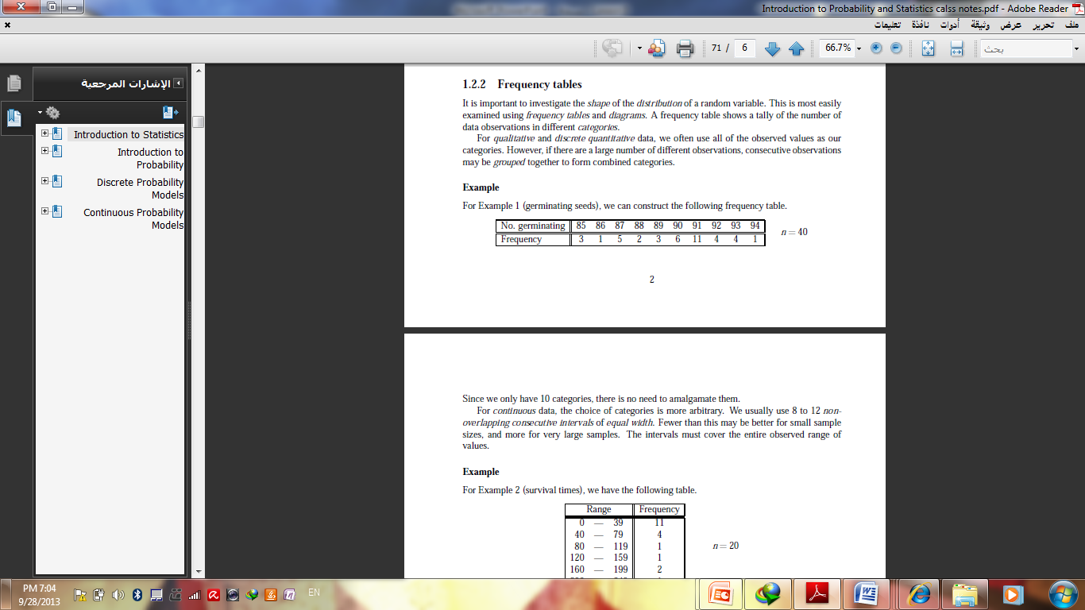
Example 1: Making a Frequency Table
n : total of frequency
The interval must equal width.
Use for qualitative and discrete data.
You should cover all values and categories.

Slide 6
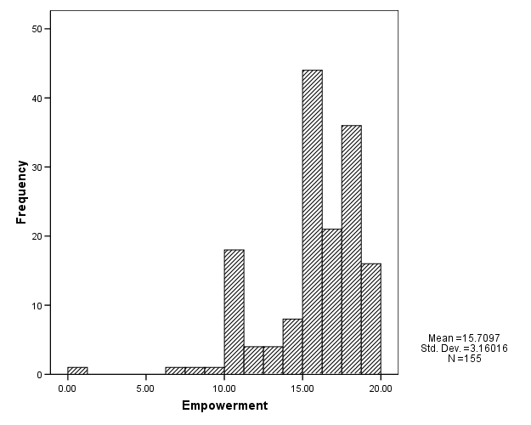
2.Histogram
A histogram is a bar graph used to display the frequency of data divided into equal intervals. The bars must be of equal width and should touch, but not overlap.
Histogram: A graph in which the classes are marked on the horizontal axis and the class frequencies on the vertical axis. The class frequencies are represented by the heights of the bars and the bars are drawn adjacent to each other.

Slide 7
Example 1: Making a Histogram
Use the frequency table in Example 2 to make a histogram.
Step 1 Use the scale and interval from the frequency table.
Enrollment in Western
Civilization Classes
Step 2 Draw a bar for the number of classes in each interval.
Number Enrolled | Frequency
1 – 10 | 1
11 – 20 | 4
21 – 30 | 5
31 – 40 | 2
All bars should be the same width. The bars should touch, but not overlap.

Slide 8
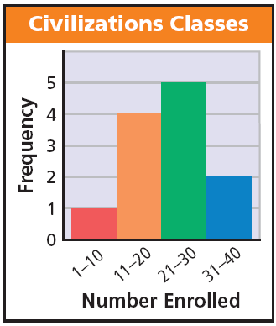
Example 1 Continued
Step 3 Title the graph
and label the horizontal and vertical scales.

Slide 9
Example 2
Make a histogram for the number of days of Maria’s last 15 vacations.
4, 8, 6, 7, 5, 4, 10, 6, 7, 14, 12, 8, 10, 15, 12
Step 1 Use the scale and interval from the frequency table.
Number of Vacation Days
Interval | Frequency
4 – 6 | 5
7 – 9 | 4
10 – 12 | 4
13 – 15 | 2

Slide 10
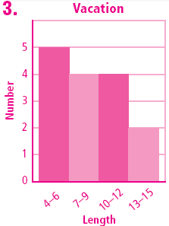
Example 2 Continued
Step 2 Draw a bar for the number of scores in each interval.
Vacations
Step 3 Title the graph
and label the horizontal and vertical scales.

Slide 11
3. Bar chart and frequency polygon
Bar chart
The scores/categories along the x-axis and the frequencies on the
y-axis.
When data discreet and the frequency refer to individual values we use bar chart.
The bars do not touch (unlike a histogram).
The scores are not ordered.
The heights correspond to the number of times the score occurs.

Slide 12
Example
The following table represents distribution of students according to their faculties in one of universities:
Faculty | Students
Science | 150
Medicine | 100
Arts | 250
Education | 300
Economics | 200
Total | 1000

Slide 13
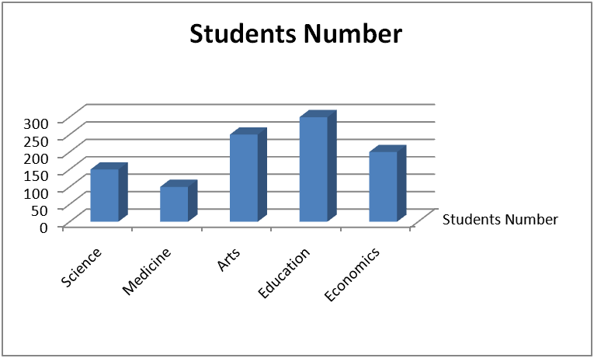
Example

Slide 14
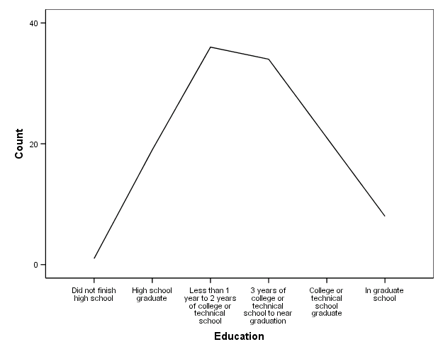
3. Bar chart and frequency polygon
frequency polygon
The scores/categories along the x-axis and the frequencies on the
y-axis.
A frequency polygon consists of line segments connecting the points formed
by the class midpoint and the class frequency.
A frequency polygon is similar to a histogram, except line segments are used instead of bars – the points formed by the intersections of the class midpoints and the class frequencies.

Slide 15
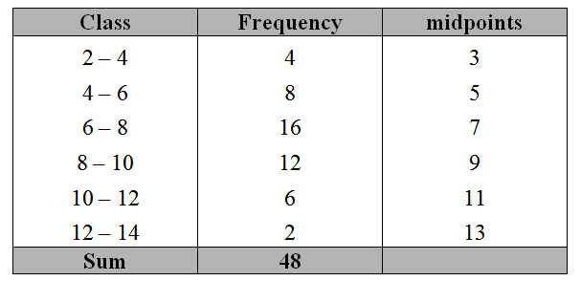
Example
Draw a polygon for the following data
To draw polygon we need to compute classes midpoints

Slide 16
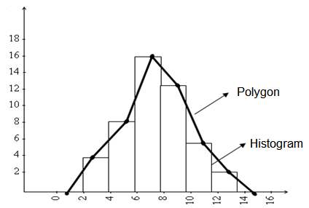
Example

Slide 17
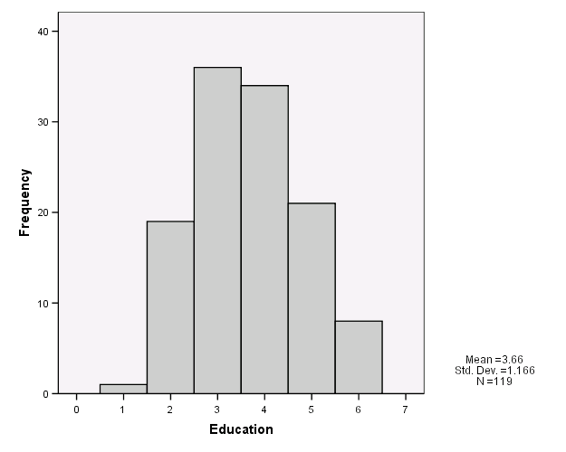
Compare the Frequency Polygon to the Histogram
To turn a histogram into a frequency polygon, just draw a line from the top center of each bar

Slide 18
Pie chart
pie chart (or a circle graph) is a circular chart divided into sectors, illustrating numerical proportion.
A pie chart is a circle that is divided into sections according to the percentage of frequencies in each category of the distribution.

Slide 19
4.Stem and Leaf Plots
A simple graph for quantitative data
Uses the actual numerical values of each data point.
Divide each measurement into two parts: the stem and the leaf.
List the stems in a column, with a vertical line to their right.
For each measurement, record the leaf portion in the same row as its matching stem.
Order the leaves from lowest to highest in each stem.
The range is the difference between the greatest and the least value.

Slide 20
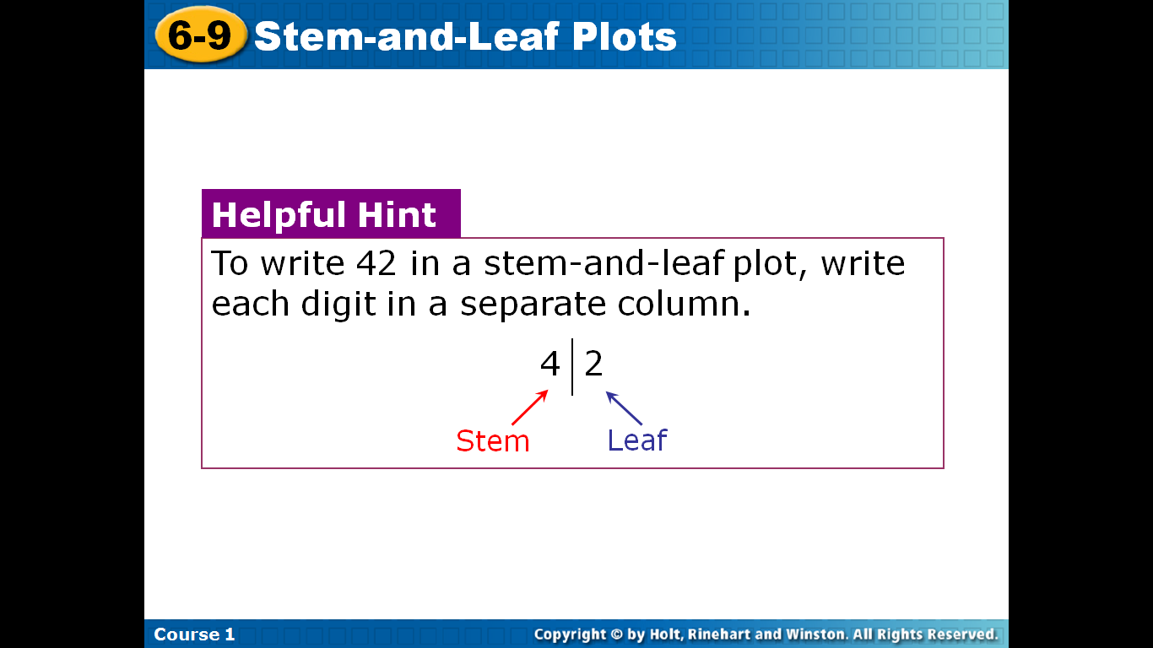
4.Stem and Leaf Plots
To write 42 in a stem-and-leaf plot, write each digit in a separate column.

Slide 21
Example
The prices ($) of 18 brands of walking shoes:
90 70 70 70 75 70 65 68 60
74 70 95 75 70 68 65 40 65
4 0
5
6 5 8 0 8 5 5
7 0 0 0 5 0 4 0 5 0
8
9 0 5
4 0
5
6 0 5 5 5 8 8
7 0 0 0 0 0 0 4 5 5
8
9 0 5
Reorder
n= 18
Range=95-40=55
greatest value=95
Leaf unit = 1
least value =40
stem unit = 10

Slide 22
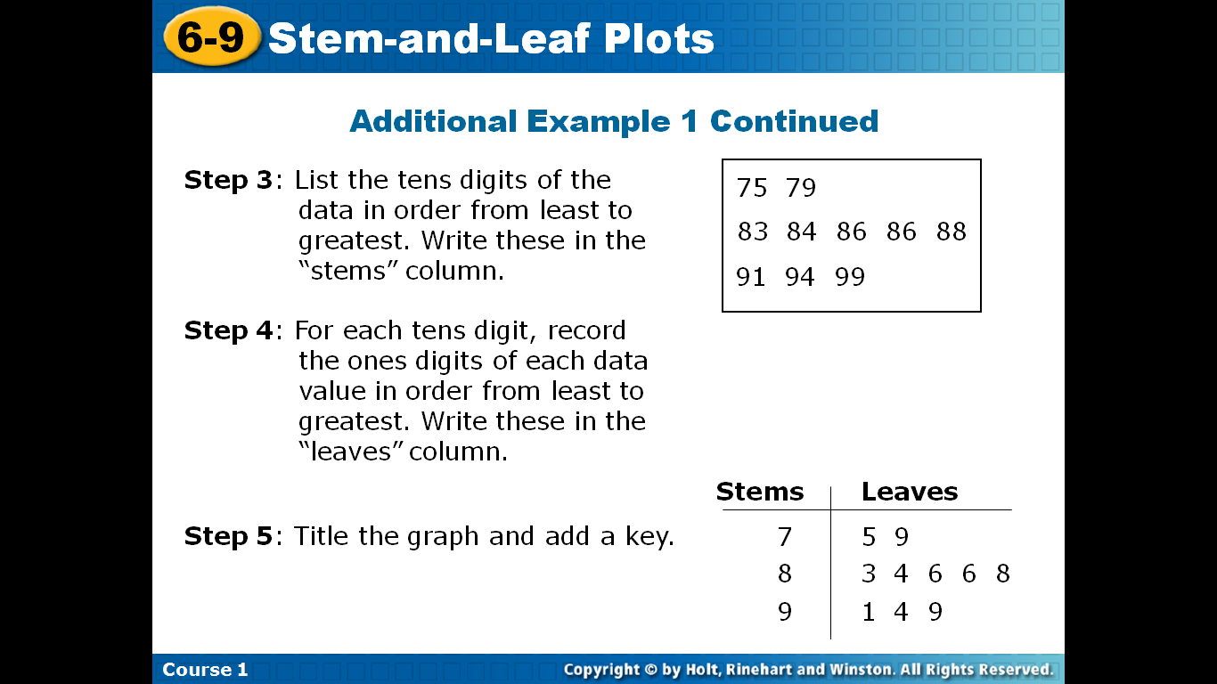
Example : Creating Stem-and-Leaf Plots
Use the data in the table to make a stem-and-leaf plot.
Test Scores
75 | 86 | 83 | 91 | 94
88 | 84 | 99 | 79 | 86
What is the least value?
What is the greatest value?
n=?
Leaf unit?
Stream unit?
Range?

Slide 23
Exercise
Use the data in the table to make a stem-and-leaf plot.
Find the least value, greatest value, range of the data.
Test Scores
72 | 88 | 64 | 79 | 61
84 | 83 | 76 | 74 | 67

Slide 24
Presentation of Data
1. Qualitative or categorical data
a. Pie charts
b. Bar charts
2. Quantitative data
a. Pie and bar charts
b. Stem and leaf

Slide 25
central tendency
Three measures of central tendency are commonly used in statistical analysis - the mode, the median, and the mean.
The data (observations) often tend to be concentrated around the center of the data.
Some measures of location are: the mean, median and mode.
These measures are considered as representatives (or typical values) of the data.

Slide 26
Arithmetic Mean or Average
The mean of a set of measurements is the sum of the measurements divided by the total number of measurements.
where n = number of measurements

Slide 27
The Sample Mean:
If the list is a statistical population, then the mean of that population is called a population mean ,denoted by µ.
If the list is a statistical sample, we call the resulting statistic a sample mean. denoted by .

Slide 28
Example
The set: 2, 9, 1 1, 5, 6
If we were able to enumerate the whole population, the population mean would be called μ .

Slide 29
Arithmetic Mean or Average
Finding the Mean?
If X = {3, 5, 10, 4, 3}
X = (3 + 5 + 10 + 4 + 3) / 5
= 25 / 5
= 5

Slide 30
Median
The median of a set of measurements is the middle measurement when the measurements are ranked from smallest to largest.
The position of the median is
.5(n + 1)
once the measurements have been ordered.

Slide 31
Example
The set: 2, 4, 9, 8, 6, 5, 3 n = 7
Sort: 2, 3, 4, 5, 6, 8, 9
Position: .5(n + 1) = .5(7 + 1) = 4th
Median = 4th largest measurement
The set: 2, 4, 9, 8, 6, 5 n = 6
Sort: 2, 4, 5, 6, 8, 9
Position: .5(n + 1) = .5(6 + 1) = 3.5th
Median = (5 + 6)/2 = 5.5 — average of the 3rd and 4th measurements

Slide 32
Mode
The mode is the measurement which occurs most frequently.
The set: 2, 4, 9, 8, 8, 5, 3
The mode is 8, which occurs twice
The set: 2, 2, 9, 8, 8, 5, 3
There are two modes—8 and 2 (bimodal)
The set: 2, 4, 9, 8, 5, 3
There is no mode (each value is unique).

Slide 33
Example
The number of quarts of milk purchased by 25 households:
0 0 1 1 1 1 1 2 2 2 2 2 2 2 2 2 3 3 3 3 3 4 4 4 5
Mean?
Median?
Mode?

Slide 34
Exercise
Find the Median , mode, mean?
4 5 6 6 7 8 9 10 12
5 6 6 7 8 9 10 12
4, 5, 8, 7

Slide 35
Exercise
For what value of X will 8 and X have the same sample mean as 27 and 5?
Solution:
First, find the mean of 27 and 5:
Now, find the X value, knowing that the sample mean of X and 8 must be 16 :
cross multiply and solve: 32 = X + 8
X =24

Slide 36
Exercise
On his first 5 Stat. tests, Omer received the following marks : 72, 86, 92, 63, and 77. What test mark must Omer earn on his sixth test so that his average for all six tests will be 80? .
Solution
Set up an equation to represent the situation.
X= 90
Omer must get a 90 on the sixth test.

Slide 37
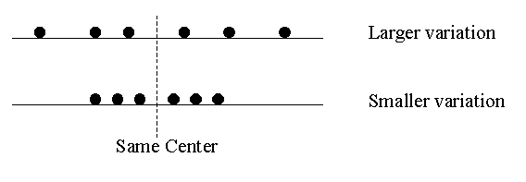
Measures of Dispersion
The variation or dispersion in a set of data refers to how spread out the observations are from each other.
The variation is small when the observations are close together. There is no variation if the observations are the same.

Slide 38
Measures of Dispersion
Measures of dispersion are important for describing the spread of the data, or its variation around a central value . or express quantitatively the degree of variation or dispersion of values.
There are various methods that can be used to measure the dispersion of a data set, each with its own set of advantages and disadvantages.

Slide 39
The Range
The difference between the largest and smallest sample values
If X1,X2,………..,Xn are the values of observations in a sample then range is given by:

Slide 40
The Range (Example):
find The range of (12, 24, 19, 20, 7) .
Solution:
One of the simplest measures of variability to calculate.
Depends only on extreme values and provides no information about how the remaining data is distributed.

Slide 41
Mean Absolute Deviation(M.A.D.)
The key concept for describing normal distributions
and making predictions from them is called
deviation from the mean.
We could just calculate the average distance between each observation and the mean.
We must take the absolute value of the distance, otherwise they would just cancel out to zero!
Formula:

Slide 42
Mean Deviation: An Example
Data: X = {6, 10, 5, 4, 9, 8}
X = 42 / 6 = 7
X – Xi | Abs. Dev.
7 – 6 | 1
7 – 10 | 3
7 – 5 | 2
7 – 4 | 3
7 – 9 | 2
7 – 8 | 1
Compute X (Average)
Compute X – X and take the Absolute Value to get Absolute Deviations
Sum the Absolute Deviations
Divide the sum of the absolute deviations by N
Total: 12
12 / 6 = 2

Slide 43
The Population Variance:
If X1,X2,………..,XN are the population values, then the population variance is:
Using summation form:
Where μ is population mean

Slide 44
The Sample Variance:
If X1,X2,………..,Xn are the population values, then the population variance is:
Using summation form:

Slide 45
The Sample Variance:
Where:
is the sample mean.
Note:
(n −1) : is called the degrees of freedom (df) associated with the sample variance S2.

Slide 46
The Sample Standard Deviation :
The standard deviation is another measure of variation. It is the square root of the variance, i.e., it is:

Slide 47
Example 1 :
Compute the sample variance and standard deviation of the following observations (ages in year): 10, 21, 33, 53, 54.
Solution
(year)

Slide 48
Example 1 :
The sample standard deviation is:

Slide 49
The Sample Variance(another formula):
Another Formula for Calculating S²:
(It is simple and more accurate)

Slide 50
The Sample Variance(another formula):
For the previous Example,
 | 10 | 21 | 33 | 53 | 54
 | 100 | 441 | 1089 | 2809 | 2916

Slide 51

Calculate the Sample Variance
Use the Definition Formula:
 | 5 | -4 | 16
 | 12 | 3 | 9
 | 6 | -3 | 9
 | 8 | -1 | 1
 | 14 | 5 | 25
Sum | 45 | 0 | 60

Slide 52
Exercise
Compute the Range, sample variance and standard deviation of the following observations :5,12,6,8,14

Slide 53
Exercise
 | 5 | 25
 | 12 | 144
 | 6 | 36
 | 8 | 64
 | 14 | 196
Sum | 45 | 465

Slide 54
InterQuartile Range (1/7)
(The Range of the middle 50% of scores)
IQR =
Q3 – Q1
What are Q3 and Q1?
Q1 is the lower quartile of 25th percentile.
Q3 is the upper quartile of 75th percentile.
6
Example 1
1, 3, 5, 6, 7, 8, 8
Median =
3
Q3 =
Q1 =
8
IQR = Q3 - Q1
Middle of
top half.
Middle of
lower half.
= 8 - 3
= 5
Notes:
54

Slide 55
Inter-quartile Range
6
Example 2
2, 3, 6, 6, 7, 8.
Median =
7
3
Q3 =
Q1 =
IQR = Q3 - Q1
Middle of
top half.
Middle of
lower half.
= 7 - 3
= 4
6.5
Example 3
2, 3, 5, 6, 7, 9, 9, 10.
Median =
9
4
Q3 =
Q1 =
IQR = Q3 - Q1
Middle of
top half.
Middle of
lower half.
= 9 - 4
= 5
Notes:
55

Slide 56
Inter-quartile Range and Dot Plots
Median
Q1
Q3
0
1
2
3
4
5
6
7
8
IQR = Q3 – Q1
= 5 – 2
= 3
Notes:
56

Slide 57
Drawing a Box Plot.
Example 1: Draw a Box plot for the data below
Q₁
Q₂
Q₃
4, 4, 5, 6, 8, 8, 8, 9, 9, 9, 10, 12
Lower Quartile = 5½
Upper Quartile = 9
Median = 8
4
5
6
7
8
9
10
11
12

Slide 58
Drawing a Box Plot.
Example 2: Draw a Box plot for the data below
Q₁
Q₂
Q₃
3, 4, 4, 6, 8, 8, 8, 9, 10, 10, 15,
Lower Quartile = 4
Upper Quartile = 10
Median = 8
3
4
5
6
7
8
9
10
11
12
13
14
15

Slide 59
Drawing a Box Plot.
Question: Stuart recorded the heights in cm of boys in his class as shown below. Draw a box plot for this data.
137, 148, 155, 158, 165, 166, 166, 171, 171, 173, 175, 180, 184, 186, 186

Slide 60
Drawing a Box Plot.
Question: Stuart recorded the heights in cm of boys in his class as shown below. Draw a box plot for this data.
Q_{L}
Q₂
Q_{u}
137, 148, 155, 158, 165, 166, 166, 171, 171, 173, 175, 180, 184, 186, 186
Lower Quartile = 158
Upper Quartile = 180
Median = 171
130
140
150
160
170
180
cm
190

Slide 61
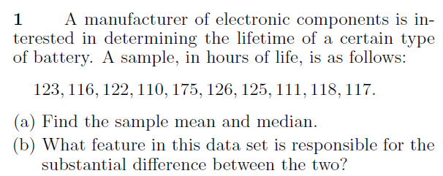
Exercises

Slide 62
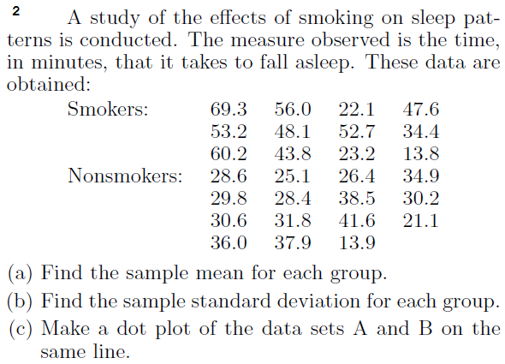
Exercises

Slide 63
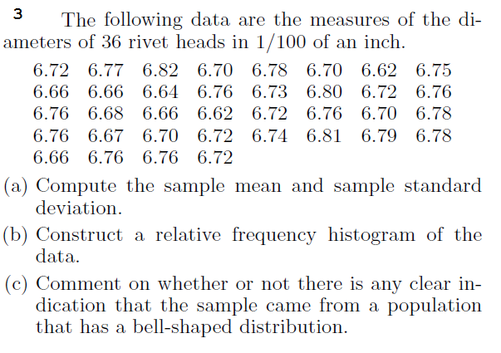
Exercises

Slide 64
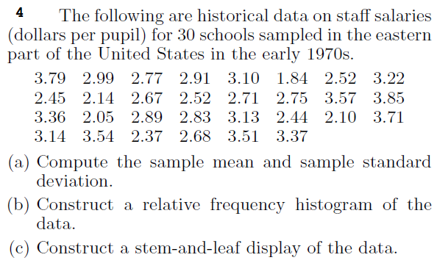
Exercises

Slide 65
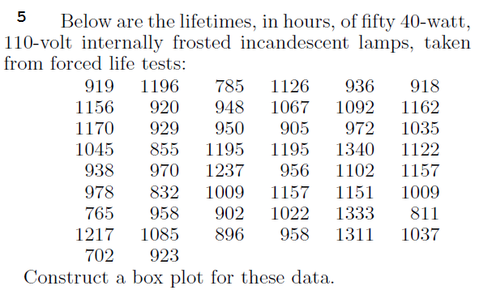
Exercises

